Slide 1


Cse 676 Deep Learning Project 2
CycleaGAN^{[1]} - Face domain translation
By: tingting wang, Xinguo zhu, yi huo
UbID: twang49, xinguozh, yihuo

Slide 2
Agenda
Introduction to cycle gan
Project Goal
Dataset
Network architecture
Loss Function
Optimizer
Evaluation Metrics
Training process
Results
Reference

Slide 3

Agenda
Introduction to cycle gan
Project Goal
Dataset
Network architecture
Loss Function
Optimizer
Evaluation Metrics
Training process
Results
Reference

Slide 4






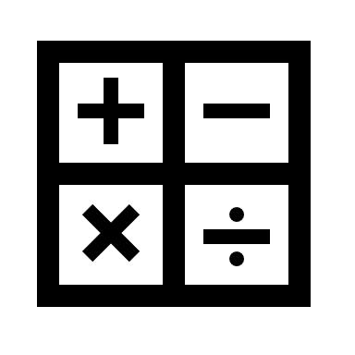


Navigation panel
Introduction
Project Goal
Dataset
Architecture
Loss Function
Optimizer
Eval. Metrics
Train Process
Results

Slide 5
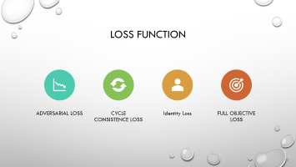
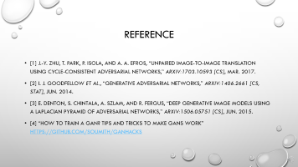
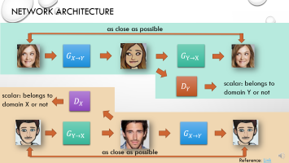
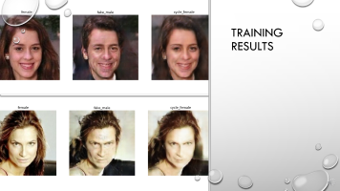
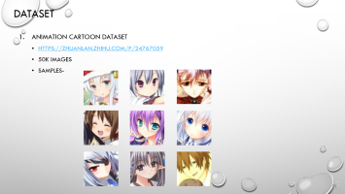
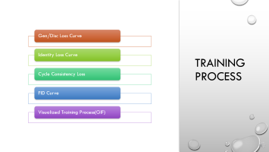
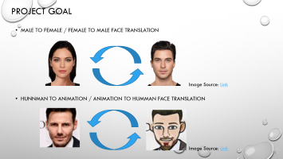
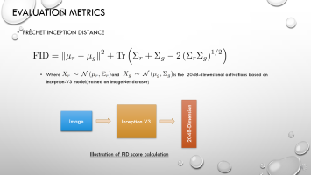
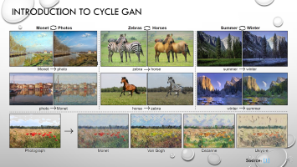
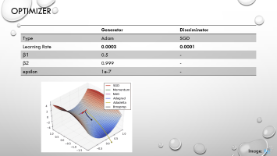
Agenda
Introduction
Project Goal
Dataset
Architecture
Loss Function
Optimizer
Eval. Metrics
Train Process
Results
Reference

Slide 6
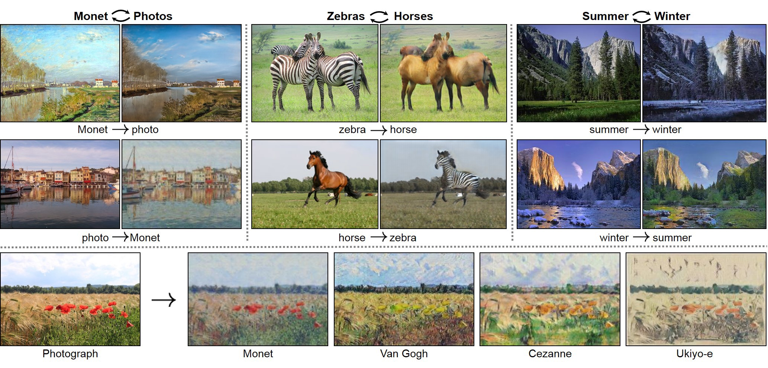
Introduction to cycle gan
Unpaired image domain translation
Source: [1]

Slide 7
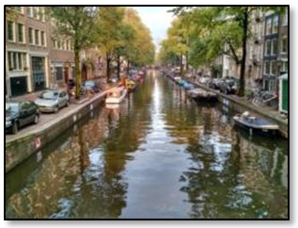
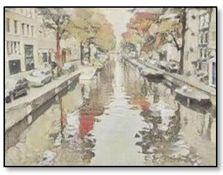
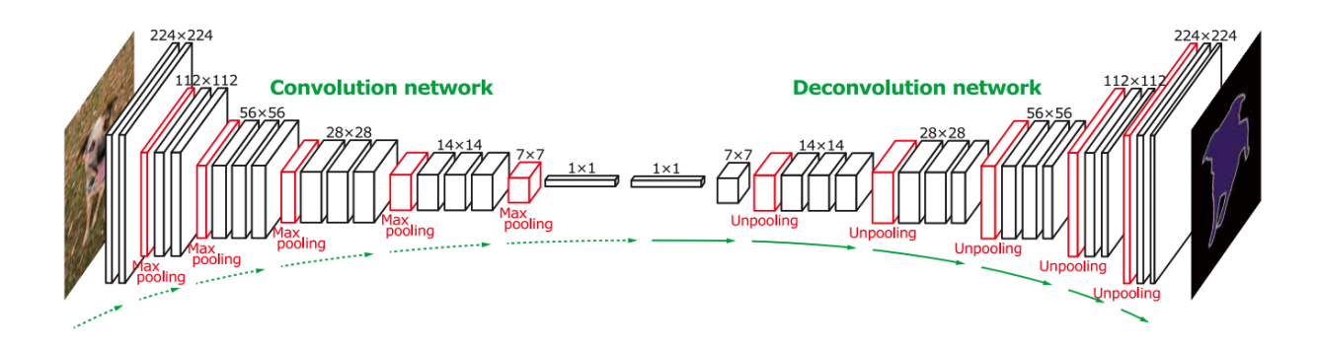
Introduction to cycle gan
Domain X
Domain Y
Transform an object from one domain to another without paired data
Reference: Link

Slide 8
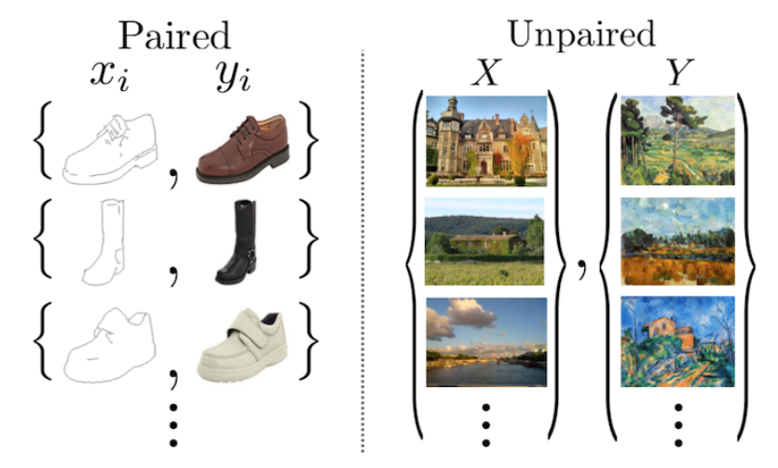
Introduction to cycle gan
Pix2Pix GAN
Cycle GAN
Source: [1]
Notes:
CycleGAN builds on earlier work called Pix2Pix. The Pix2Pix network requires paired translations, which means that while training, for each input, you need to specify exactly what the output should look like. CycleGAN instead just requires two unpaired collections of images and will do its best to find the mapping between them, without you having to specify what the pairs are.

Slide 9
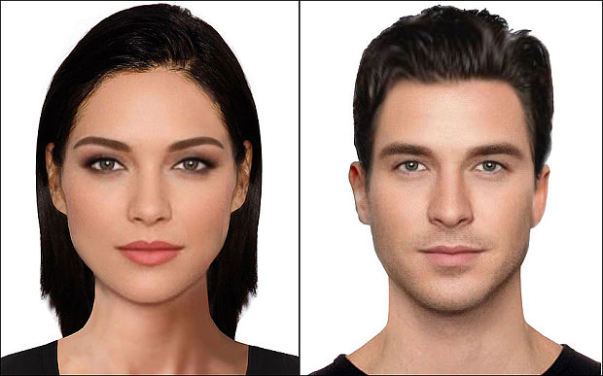
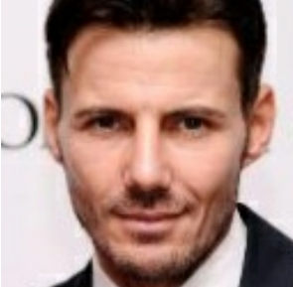

Project Goal
MALE TO FEMALE / FEMALE TO MALE FACE TRANSLATION
HUNNMAN TO ANIMATION / ANIMATION TO HUMMAN FACE TRANSLATION
Image Source: Link
Image Source: Link

Slide 10









dataset
Animation cartoon dataset
https://zhuanlan.zhihu.com/p/24767059
50k images
samples-

Slide 11
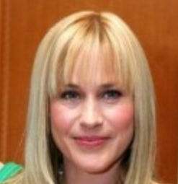
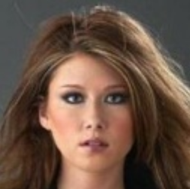
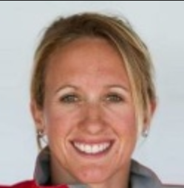


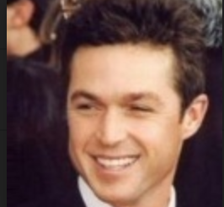
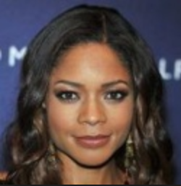
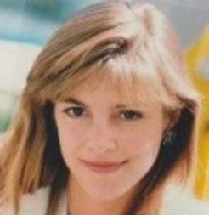
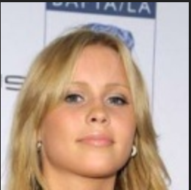

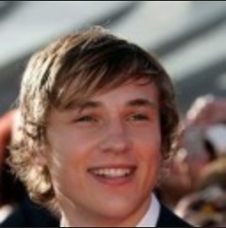

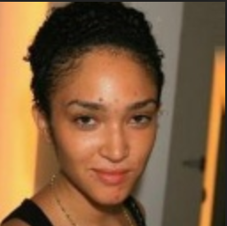
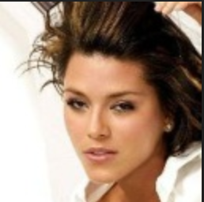
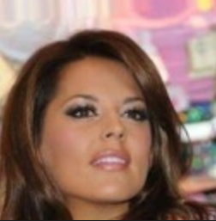
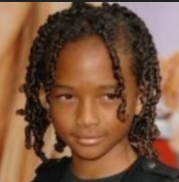
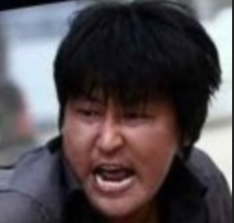

dataset
Human faces
Source (Link)
Total of 10k female faces and 10K male faces
Samples-

Slide 12









dataset
Emoji
Dataset from: (Link)
Total of 10k samples
Samples-

Slide 13
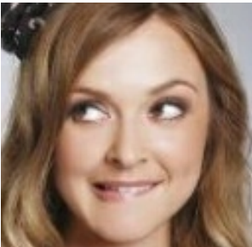
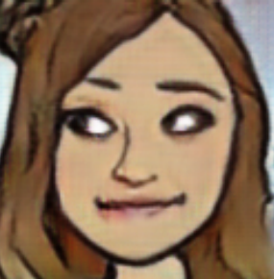

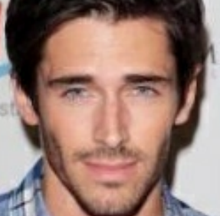
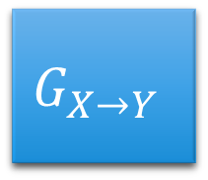
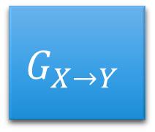
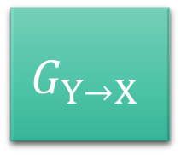

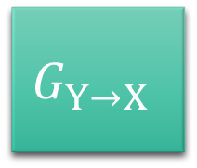
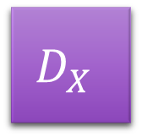
Network Architecture
as close as possible
$$G_{X→Y}$$
$$G_{Y→X}$$
$$D_{Y}$$
scalar: belongs to domain Y or not
scalar: belongs to domain X or not
$$D_{X}$$
$$G_{Y→X}$$
$$G_{X→Y}$$
as close as possible
Reference: Link

Slide 14
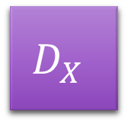

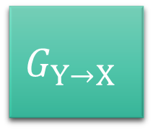
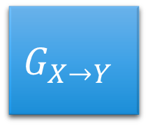
Network Architecture
$$G_{X→Y}$$
Generator X to Y
Generator Y to X
Discriminator X
Discriminator Y
$$G_{Y→X}$$
Generator Architecture
$$D_{X}$$
Logit
$$D_{Y}$$
Discriminator Architecture

Slide 15
Generator architecture
128 X128 X3
128 X128 X3
64 X 64 X64
64 X 64 X64
32 X 32 X 128
16 X 16 X256
16 X 16 X256
32 X 32 X 128
8x8x512
8x8x512
4xX4X512
2xX2X512
2xX2X512
4xX4X512
1X1X512
Generator Architecture
Conv with stride = 2
Trams Conv with stride = 2
Batch Normalization
Batch Normalization
Dropout Layer
Relu()
Relu()
Typical Upsampling Block
Typical Downsampling Block
Concatenation

Slide 16
Discriminator architecture
128 X128 X3
64 X 64 X64
32 X 32 X 128
16 X 16 X256
8x8x512
4xX4X512
Flatten: 1X(4*4*512)
1
Discriminator Architecture
Conv with stride = 2
Batch Normalization
Dropout Layer
Relu()
Typical Downsampling Block

Slide 17
Network Summary
 | Generator | Discriminator
# of Blocks | 16 | 8
# of Parameters | 41.8 M | 6.9M
Remember we have 2 generators and 2 discriminators, so 2x parameters to train!
Reference: Link

Slide 18
Loss Function
Adversarial Loss
Cycle Consistence Loss
Full objective loss
Identity Loss

Slide 19
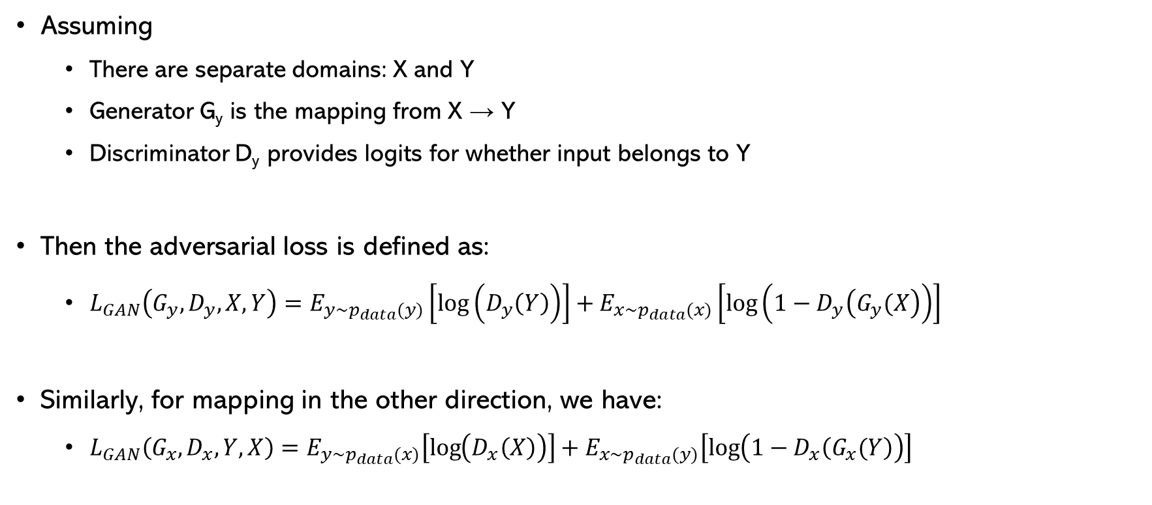
Adversarial loss
Assuming
There are separate domains: X and Y
Generator G_{y} is the mapping from X → Y
Discriminator D_{y} provides logits for whether input belongs to Y
Then the adversarial loss is defined as:
$L_{GAN}\left(G_{y},D_{y}, X, Y\right)=E_{y\sim p_{data}(y)}\left[\log\left(D_{y}\left(Y\right)\right)\right]+E_{x\sim p_{data}(x)}\left[\log\left(1−D_{y}\left(G_{y}(X\right)\right)\right]$
Similarly, for mapping in the other direction, we have:
$L_{GAN}\left(G_{x},D_{x}, Y, X\right)=E_{y\sim p_{data}(x)}\left[\log\left(D_{x}\left(X\right)\right)\right]+E_{x\sim p_{data}(y)}\left[\log\left(1−D_{x}\left(G_{x}(Y\right)\right)\right]$

Slide 20
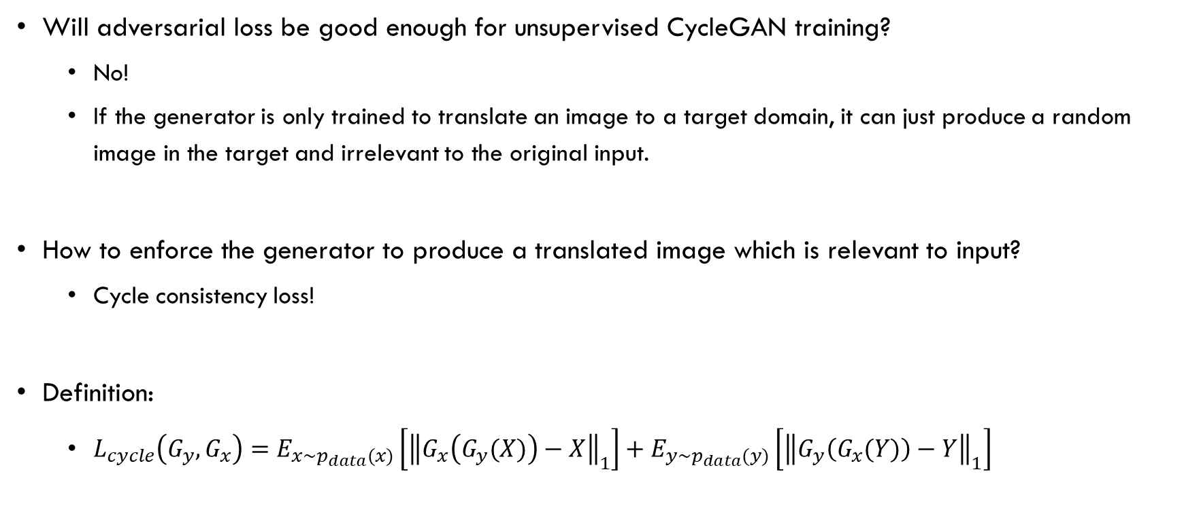
Cycle Consistency Loss
Will adversarial loss be good enough for unsupervised CycleGAN training?
No!
If the generator is only trained to translate an image to a target domain, it can just produce a random image in the target and irrelevant to the original input.
How to enforce the generator to produce a translated image which is relevant to input?
Cycle consistency loss!
Definition:
$L_{cycle}\left(G_{y},G_{x}\right)=E_{x\sim p_{data}(x)}\left[{\left\|G_{x}\left(G_{y}(X)\right)−X\right\|}_{1}\right]+E_{y\sim p_{data}(y)}\left[{\left\|G_{y}\left(G_{x}(Y)\right)−Y\right\|}_{1}\right]$
Notes:
Adversarial training can, in theory, learn mappings G and F that produce outputs identically distributed as target domains Y and X respectively (strictly speaking, this requires G and F to be stochastic functions) [15].
However, with large enough capacity, a network can map the same set of input images to any random permutation of images in the target domain, where any of the learned mappings can induce an output distribution that matches the target distribution.
Thus, adversarial losses alone cannot guarantee that the learned function can map an individual input xi to a desired output yi .

Slide 21
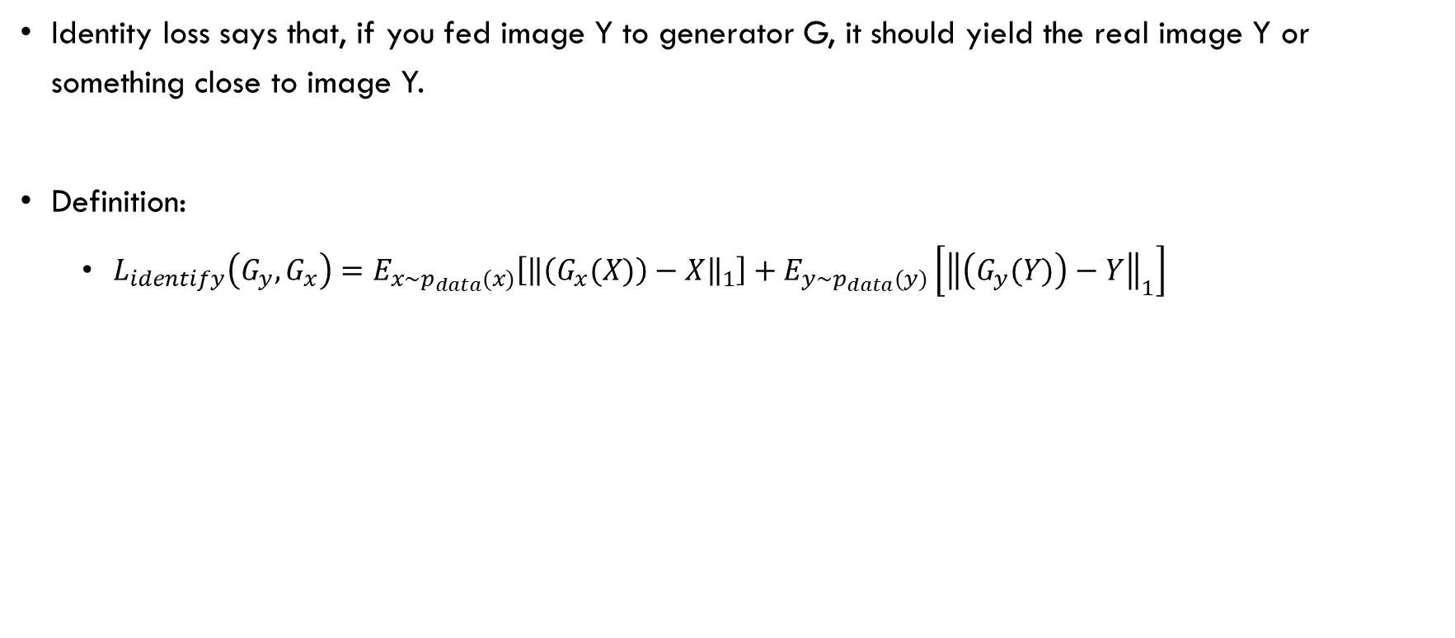
Identity Loss
Identity loss says that, if you fed image Y to generator G, it should yield the real image Y or something close to image Y.
Definition:
$L_{identify}\left(G_{y},G_{x}\right)=E_{x\sim p_{data}(x)}\left[{\left\|\left(G_{x}(X)\right)−X\right\|}_{1}\right]+E_{y\sim p_{data}(y)}\left[{\left\|\left(G_{y}(Y)\right)−Y\right\|}_{1}\right]$

Slide 22
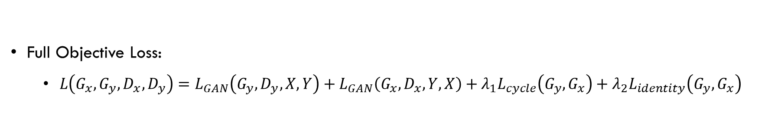
Full Objective Loss
Full Objective Loss:
$L\left(G_{x}, G_{y}, D_{x}, D_{y}\right)=L_{GAN}\left(G_{y},D_{y}, X, Y\right)+L_{GAN}\left(G_{x},D_{x}, Y, X\right)+{λ_{1}L}_{cycle}\left(G_{y},G_{x}\right)+{λ_{2}L}_{identity}\left(G_{y},G_{x}\right)$
[Adversarial Loss]
[Cycle Consistency Loss]
Identity Loss

Slide 23

Optimizer
 | Generator | Discriminator
Type | Adam | SGD
Learning Rate | 0.0003 | 0.0001
β1 | 0.5 | -
β2 | 0.999 | -
epsilon | 1e-7 | -
Image: Ref

Slide 24
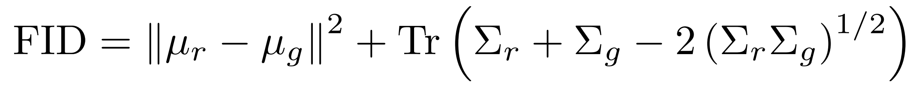
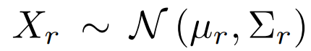
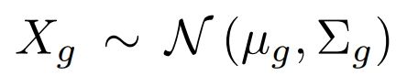
Evaluation Metrics
Fréchet Inception distance
Where and is the 2048-dimensional activations based on Inception-V3 model(trained on ImageNet dataset)
2048-Dimension
Inception V3
Image
Illustration of FID score calculation

Slide 25
Training Process
Gen/Disc Loss Curve
Identity Loss Curve
Cycle Consistency Loss
FID Curve
Visualized Training Process(GIF)

Slide 26
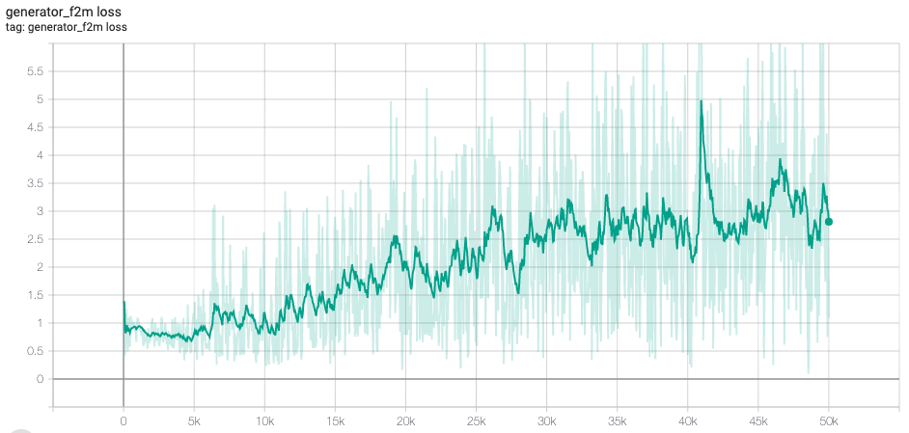

Generator Loss
F2M Generator
M2F Generator

Slide 27


Discriminator Loss
M Discriminator
F Discriminator

Slide 28

Cycle Consistency Loss

Slide 29


Identity loss
Male
Female

Slide 30

FID Curve

Slide 31


Training Gifs

Slide 32


Training Gifs

Slide 33



Training results

Slide 34


Training results

Slide 35


Training results

Slide 36


Training results

Slide 37


Training Process

Slide 38


Training Process

Slide 39


Training Process

Slide 40
REFERENCE
[1] J.-Y. Zhu, T. Park, P. Isola, and A. A. Efros, “Unpaired Image-to-Image Translation using Cycle-Consistent Adversarial Networks,” arXiv:1703.10593 [cs], Mar. 2017.
[2] I. J. Goodfellow et al., “Generative Adversarial Networks,” arXiv:1406.2661 [cs, stat], Jun. 2014.
[3] E. Denton, S. Chintala, A. Szlam, and R. Fergus, “Deep Generative Image Models using a Laplacian Pyramid of Adversarial Networks,” arXiv:1506.05751 [cs], Jun. 2015.
[4] “How to Train a GAN? Tips and tricks to make GANs work” https://github.com/soumith/ganhacks

